Slide 1

Let Me Unwind That For You: Exceptions to Backward Edge
DECEMBER 4, 2023
Presented by Manjinder Singh | Harbhajan Singh | Karan Vishavjit
Notes:
Slide 1: Research Paper Title - "Let Me Unwind That For You: Exceptions to Backward Edge Protection"
Good [morning/afternoon/evening], everyone. Today, I'm excited to present a research paper titled "Let Me Unwind That For You: Exceptions to Backward Edge Protection.” Let's dive into the key aspects of this intriguing study.
Victor Duta∗§, Fabian Freyer†§, Fabio Pagani‡, Marius Muench∗ and Cristiano Giuffrida∗
∗Vrije Universiteit Amsterdam,
‡University of California, Santa Barbara, pagani@ucsb.edu
Joint first authors

Slide 2
MAIN POINTS
Today's Discussion
Introduction
Paper Overview
Problem
Existing Protections
New Paradigms
Conclusion
Notes:
Slide 2: Table of Contents (TOC)
Before we jump into the paper, let's take a quick look at the table of contents. We'll commence with an introduction, followed by an overview of the paper, an exploration of the identified problem, a discussion on existing protections, going through emerging paradigms, and finally, conclude with the implications drawn from the research.

Slide 3

●The paper investigates backward-edge control-ﬂow hijacking in software exploitation, challenging the assumption that attackers need to directly manipulate return addresses.
● It introduces Catch Handler Oriented Programming (CHOP), exploiting stack corruption to divert execution to controlled catch handlers, enabling powerful primitives like arbitrary code execution.
●The study demonstrates CHOP's applicability across platforms, surveys open-source packages to identify exploitable exception handlers, and concludes with proposed mitigations.
●This research uncovers novel attack opportunities, emphasizing the evolving landscape of control-ﬂow manipulation and the necessity for adaptive defense strategies.
PAPER OVERVIEW
Notes:
Slide 3: Paper Overview
This Research Paper delves into a fascinating facet of software exploitation—backward-edge control-flow hijacking. It Challenges the conventional belief that attackers directly manipulate return addresses, It introduces "Catch Handler Oriented Programming" (CHOP). CHOP exploits stack corruption to map execution to controlled catch handlers, enabling potent primitives like arbitrary code execution. The study demonstrates CHOP's versatility across platforms, surveys open-source packages for exploitable exception handlers, and suggests mitigations. This research unveils novel attack opportunities, underscoring the ever-changing landscape of control-flow manipulation and the need for adaptive defense strategies.

Slide 4
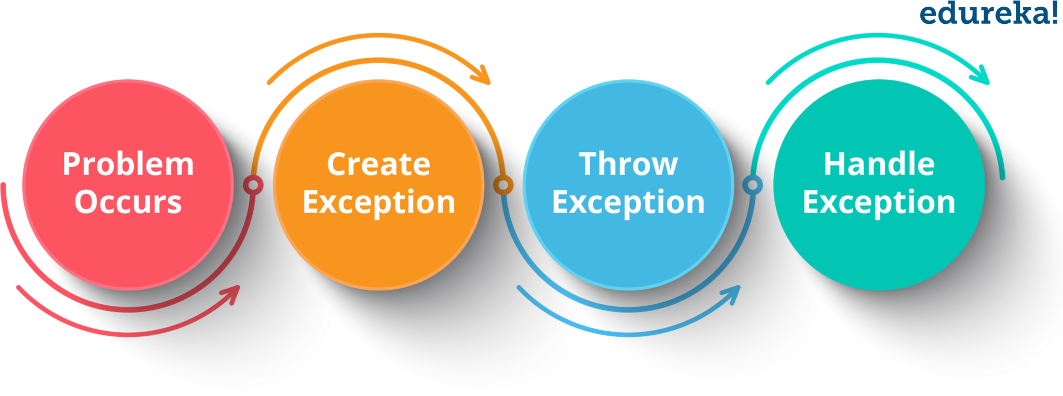
Exceptional Control Flow
●Exceptional control ﬂow is a concept in computer science and programming that refers to the path a program takes in response to unexpected or exceptional events.
●Unlike the normal control ﬂow, where a program executes sequentially or jumps to a speciﬁed section due to loops or conditions, exceptional control ﬂow is triggered by events such as errors, exceptions, or external interrupts.
●For instance, consider a program that reads a ﬁle. If the ﬁle doesn't exist, instead of crashing, the program might take an exceptional control ﬂow to handle this error, perhaps by displaying an error message to the user.
Notes:
Slide 4: Exceptional Control Flow
To understand the context, let's clarify what exceptional control flow means.
In the realm of computer science and programming, exceptional control flow refers to the path a program takes in response to unexpected events. Unlike normal control flow, where execution follows a sequential or conditional path, exceptional control flow is triggered by errors, exceptions, or external interrupts. For instance, consider a program reading a file. If the file doesn't exist, instead of crashing, the program might take an exceptional control flow to manage this error, perhaps by displaying an error message to the user.

Slide 5
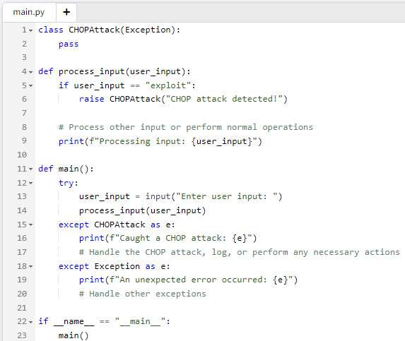
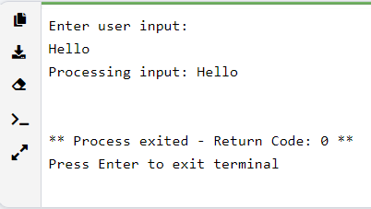
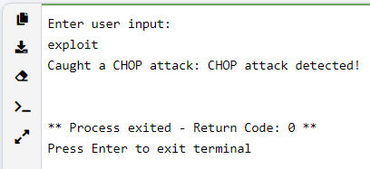
Example of Exceptional Control Flow

Slide 6
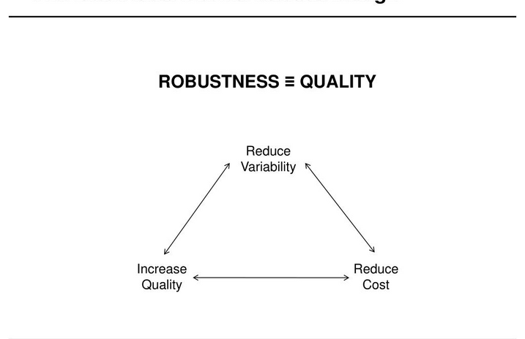


ROBUSTNESS
It allows programs to handle unexpected situations gracefully without crashing. This is vital for software reliability.
USER EXPERIENCE
IMPORTANCE OF EXCEPTIONAL CONTROL FLOW
By providing meaningful error messages or alternative actions when something goes wrong, users are not left in the dark about what happened.
SECURITY
Proper exception handling can prevent potential security vulnerabilities. For instance, without proper error handling, a program might reveal sensitive information in its error messages.
Notes:
Slide 5: Importance of Exceptional Control Flow
Now, why does exceptional control flow matter? Three vital aspects underscore its significance:
Robustness: Exceptional control flow empowers programs to handle unforeseen situations gracefully without crashing, thereby enhancing software reliability.
User Experience: By offering meaningful error messages or alternative actions when something goes awry, users are kept informed about the issue, contributing to an enhanced user experience.
Security: Proper exception handling is pivotal for security. Without it, a program might inadvertently expose sensitive information in its error messages, potentially leading to security vulnerabilities.
Handling unexpected situations, displaying error messages and handling potential security vulnerabilities are the important

Slide 7

Protection Method
1. STACK CANARIES OR SECURITY COOKIES:
Stack Canary is a protection method that adds a security check to detect buffer overflow attacks. It places a random value, called a canary, between the buffer and the return address. If the canary value is modified, an attack is detected.
Why are they Important?
Shadow attacks provide a robust mechanism against return-oriented programming i.e. ROP attacks, where attackers exploit existing code sequences in unintended ways.
Notes:
Hello everyone, now I will discuss about the protection methods used to mitigate software vulnerabilities. Two popular methods include Stack Canary and Shadow Stacks. I will discuss What are they, How do they work, and Why are they important?
What are they?
Stack canaries are random values added to the stack before the return address to enhance security.
How do they work?
Stack canaries are a security measure against buffer overflow attacks. They work by checking if an attacker has modified the canary value before a function concludes, preventing unauthorized changes to the program's flow.
Why are they Important?
Shadow attacks offer a strong defense against return-oriented programming (ROP) attacks, preventing attackers from manipulating existing code sequences for malicious purposes.

Slide 8
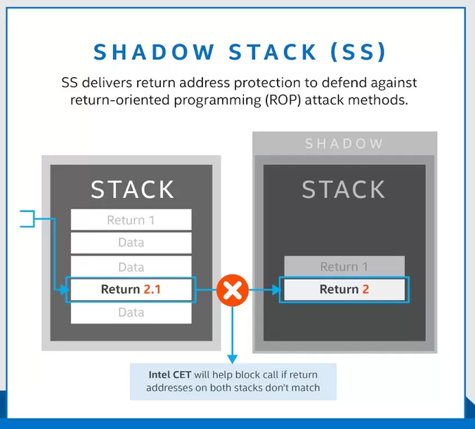
Protection Method
2. SHADOW STACKS:
Shadow Stacks is a protection method that uses a separate stack to store return addresses. It prevents attackers from modifying the original stack and hijacking the control flow.
Why are they important?​
Shadow stacks offer a straightforward and powerful way to identify stack-based buffer overflows, a prevalent method used in cyber-attacks.
​
Notes:
Second protection methos is SHADOW STACKS. Now I will discuss – what are they? And How do they work? And Why are they important?
What are they?
A Shadow stack is a separate and protected stack that stores the return addresses.
How do they work?
Every time a function is called, the return address is pushed onto both the regular stack and the shadow stack. When the function returns, the return address from the main stack is compared to the one on the shadow stack.
Why are they Important?:
Shadow stacks provide a simple yet effective mechanism to detect stack-based buffer overflows, which are common attack vectors.

Slide 9
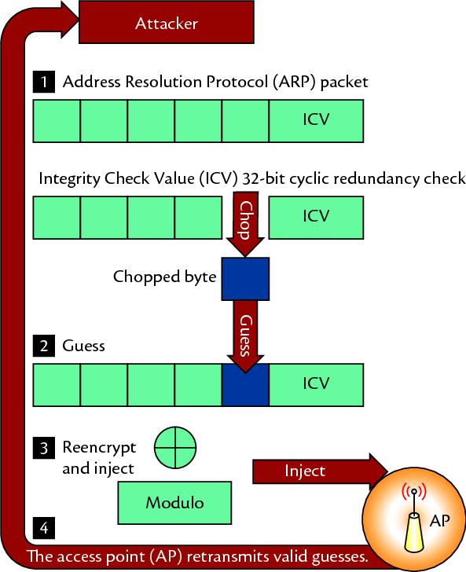
CHOP Attacks
Catch Handler-Oriented Programming (CHOP) attacks represent a new threat by focusing on exploiting weaknesses in the exception-handling mechanism of programming languages.
While exception-handling is meant to handle unforeseen situations in code, CHOP takes advantage of vulnerabilities in this system to carry out malicious actions.
The chop attack on
Wired Equivalency Privacy (WEP).
Notes:
Now, I will discuss about the attacks which are discussed and authored by the authors of the research paper, i.e. CHOP attacks:
Catch Handler-Oriented Programming (CHOP) is a novel attack paradigm that specifically targets the exception handling mechanism in the programming languages.
Exception handling is designed to manage unexpected or exceptional situations in code. However, CHOP exploits vulnerabilities within this system to achieve malicious objectives.

Slide 10
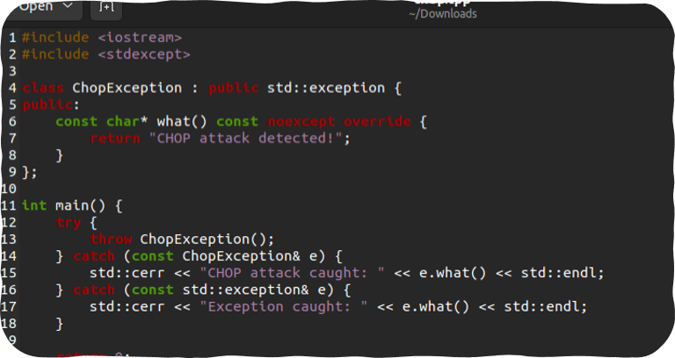
CHOP Attacks Logic

Slide 11
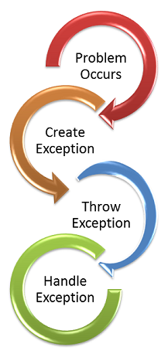
CHOP Attacks
Why is it significant?
Exception handling is crucial in modern software applications. If attackers exploit this system, they could gain unauthorized access or control over a substantial part of the software infrastructure.
Notes:
The significance of exception-handling is a fundamental component of many modern software applications, If the attackers exploit any system, they can potentially gain unauthorized access or control over a significant portion of software infrastructure or database.

Slide 12
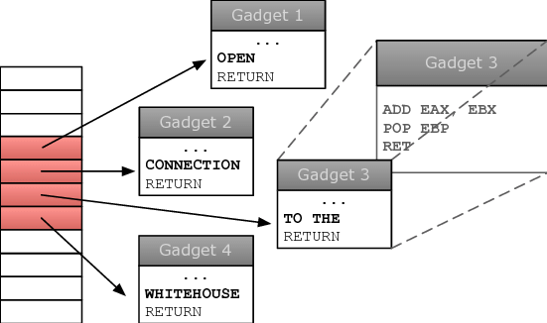
CHOP Attacks
Confusion Primitives:
Confusion Primitives are the fundamental tools attackers use to disrupt a program's error-handling routines. By manipulating these, they can divert the program's normal course, causing unintended code execution.
Gadgets:
Gadgets, within the CHOP context, are small pieces of code that, while not harmful on their own, can be combined maliciously. Attackers string together gadgets to create a sequence of operations, ultimately leading to a complete exploit.
Notes:
To explain the CHOP attacks, authors of this paper introduced two terms: i.e. Confusion Primitives and Gadgets.
Confusion Primitives:
These are basic building blocks or tools that an attacker uses to induce confusion or misbehavior in a program's exception handling routines.
By leveraging confusion primitives, attackers can manipulate the normal flow of exception handling, causing the program to execute unintended sequences of code or operations.
Gadgets:
In the context of CHOP, gadgets refer to small pieces or sequences of code that can be exploited by an attacker to perform specific tasks or operations. These are not malicious by themselves but can be used maliciously when combined in a particular sequence. In this way, it works as a tool for attackers to string together to craft a CHOP attack.

Slide 13
CHOP (Catch Handler Oriented Programming)
Attack Scenarios
Golden Gadget: Exploiting vulnerable handler within standard library by high jacking it’s control flow for example c++ standard liabray (libstdc++).
Pivot-to-ROP: Overflow stack buffer to control stack data and engage in ROP (Return Oriented Programming) even in the presence of backward edge protection.
Data-Only Corruptions: Manipulate data without altering return address. Which can leverage legit clean-up and exception handling.
Cleanup-Handler Chaining: Chain multiple fake stacks and point them to clean-up handler.
SigReturn-to-ROP: redirect stack unwinding logic to attacker controlled buffer.
Notes:
Golden Gadget:
Mechanism: The attacker corrupts the saved return address to point to a vulnerable handler usually a catch-all handler capable of indirect calls based on stack data.
Execution: When the stack unwinds due to an exception, control is transferred to this golden handler. Since the handler’s operations are based on the corrupted stack data, the attacker can divert execution to any memory location, effectively hijacking the program's control flow.
Pivot to Rop:
Mechanism: overflow the stack buffer, to control the data on the stack. This includes function pointers or return addresses.
Execution: By manipulating these pointers or addresses, the attacker can execute a sequence of return-oriented programming segments of code that are already present in the program’s memory. Which will eventually perform the attacker’s desired actions.
Data-Only:
Mechanism: overwriting local variables and saved registers in a function’s stack frame. However, the saved return address is left intact.
Execution: When an exception is raised, the corrupted data in the stack frame is used by the cleanup or exception handlers. Since the return address isn't corrupted, this approach can bypass certain security measures and perform actions like leaking memory addresses or writing arbitrary data.
Cleanup-Handler Chaining:
Mechanism: Corrupts a large part of the stack, inserting multiple fake stack frames. Each frame has a saved return address that points to a call site with a registered clean-up handler.
Execution: When an exception is raised, and the stack unwinds, all the injected clean-up handlers are executed in sequence. This chaining can lead to a series of destructive actions, similar to ROP, but using clean-up handlers.
SigReturn-to-ROP:
Mechanism: This technique is especially useful when the attacker controls a large buffer separate from the stack. The attacker creates a fake signal return (SigReturn) frame in this buffer.
Execution: The unwinder is tricked into treating this frame as part of the stack unwinding process. As a result, the stack pointer is redirected to the attacker-controlled buffer, allowing the execution of a ROP chain that resides in this buffer

Slide 14
CHOP attack processing
Dataset Collection:
Setup scripts to crawl and download 51,625 package metadata for Debian repositories.
Extract downloaded package and save file metadata like file name and path in database.
2. Identifying binaries:
Unpack 1000 priority Debian packages.
Filter to get just executable binaries and shared liabries (3303 files)
3. Attack Surface analysis:
Analyze each binary to find function calling “_stack_chk_fail”
The function has deployed stack canaries
4.Gadget Analysis:
Parse . eh_frame and .gcc_except section to extract exception handler metadata.
Associate handlers with function boundaries using call-site data
Notes:
Dataset Collection:
Crawl main AMD64 repository
Forward to Binary Ninja pipeline
Fed analysis result back to database
Identifying binaries:
Used Binary Ninja to disassemble these binaries
Checked for .gcc_except_table section or calls to cxa_throw
Identified 322 binaries with exception handling to analyze
Attack Surface Analysis
Recursively traced call graphs up to 7 levels within each binary
Checked each function in the trace if it calls the cxa_throw API
This identified all functions that can throw an exception
Estimated attack surface by correlating the above two findings
Gadget Analysis
For each handler, used Binary Ninja to start static taint tracking
A taint sink refers to a sensitive function or operation that we want to detect whether it is being influenced by user-controlled/tainted data.
a taint sink refers to a sensitive operation that we want to detect if it is being controlled by malicious user inputs
Sink Detection
Detected specific taint sink functions during analysis
Sinks matched capabilities like memory writes, code execution
If taint reached sink, reported that handler enables the capability
Ranking & Filtering
Ranked gadgets based on how feasible sinks are to reach
Provides estimate for a gadget's exploitability

Slide 15
CHOP attack Evaluation
Exception Handling Usage:
Around 10% of debian packages uses c++ exception handling.
Attack Surface:
35% of throwing functions operate on stack buffers
Gadget Capabilities:
79% binaries had arbitrary free gadgets
36% binaries had forward control flow hijack gadgets
Over 90% binaries had some powerful exploit gadget
Shadow Stacks
Mitigation mechanism to prevent overwrite of return addresses
Notes:
Evaluating Exception Handling Usage
Showed significant attack surface just focusing on exceptions
Attack Surface Analysis
Focus on functions that can have buffer overflows and throw exceptions
Indicated functions vulnerable to memory corruptions
Evaluating Gadget Capabilities (Gadgets refer to the exception handlers and cleanup handlers that execute when an exception occurs and unwinding happens)
Showed diversion to exception handlers is highly exploitable
Exception handlers and clean-up handlers executed on unwinding
Taint tracking checked what operations these can perform
E.g. arbitrary memory writes, code execution
Shows what attackers could leverage through divert attacks
Case Studies
Developed real working exploits using CHOP techniques
Bypassed Stack Guard defence in 3 real-world vulnerabilities
Worked reliably on Linux, Windows, macOS, iOS and Android
Shadow Stack Analysis
Tested CHOP against shadow stack implementations
Found all fail to protect against exception divert attacks
Showed existing shadow stack defences still vulnerable
In summary, the evaluation results successfully demonstrate:
Prevalence of exception handling in C++ programs
Stack corruptions are likely in a significant portion
Powerful exploitation is possible through exception handlers
CHOP leads to bypasses of deployed mitigations
Applicability across operating systems and architectures

Slide 16
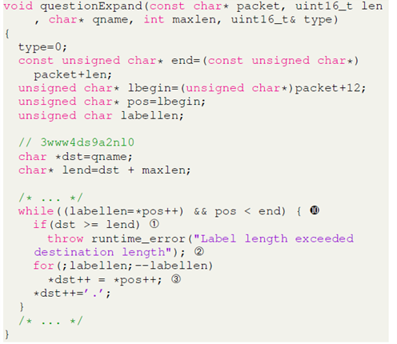
CHOP Real World Applicability
PowerDNS Recursor: Debina lenny package of PowerDNS running on Ubuntu 20.04.4 system has vulnerable code in “questionExpand” function used for DNS query processing used a fixed-size stack which can be overflowed.
LibRaw: an image processing library having buffer overflow vulnerability in “parse_exif” function when parsing images with a specific EXIF tag.
Smart-card Services on macOS: Common Access Card (CAC) module of smart-card services running on macOS Sierra has a vulnerability related to certificate data being read into a stack buffer.
Notes:
The research paper presents three case studies to highlight how CHOP can be used to exploit vulnerabilities in different software applications:
PowerDNS Recursor
Exploit Method: The overflow occurred when parsing DNS responses. The researchers sent a crafted DNS response that exceeded the buffer size the code explicitly checks whether more data
has been written into the buffer than it can hold À and throws a runtime error the check happens only after data is written in next iteration and then triggered a runtime error, exploiting the overflow.
Outcome: The overflow and subsequent exception handling allowed the researchers to overwrite the saved return address with a pointer to a "golden gadget" in the libstdc++, leading to control flow hijacking and execution of a ROP (Return-Oriented Programming) chain, ultimately opening a remote shell for the attacker​​.
2. LibRaw
Exploit Method: The exploit involved modifying maker note of an existing image created by Rasberry Pie camera to trigger the buffer overflow and overwrite the saved return address. The overflow was extended to change the camera model data, triggering a different function (parse_makernote) that threw an exception, leading to stack unwinding.
Outcome: The researchers crafted a second MakerNote tag to trigger the exception, which, combined with the corrupted stack, led to the execution of a ROP chain and allowed the attacker to execute arbitrary commands​​ which evenrually opened shell.
3. Smart-card Services on macOS
Exploit Method: The researchers used an error condition in the certificate decompression process to trigger an exception. They used the Virtual Smart Card Architecture with modifications to deliver the exploit payload.
Outcome: The payload overwrote the saved return address with a pointer to a pivot-to-ROP gadget. The ROP chain then executed commands specified by the attacker on the victim system, demonstrating CHOP's applicability beyond Linux platforms​​.

Slide 17
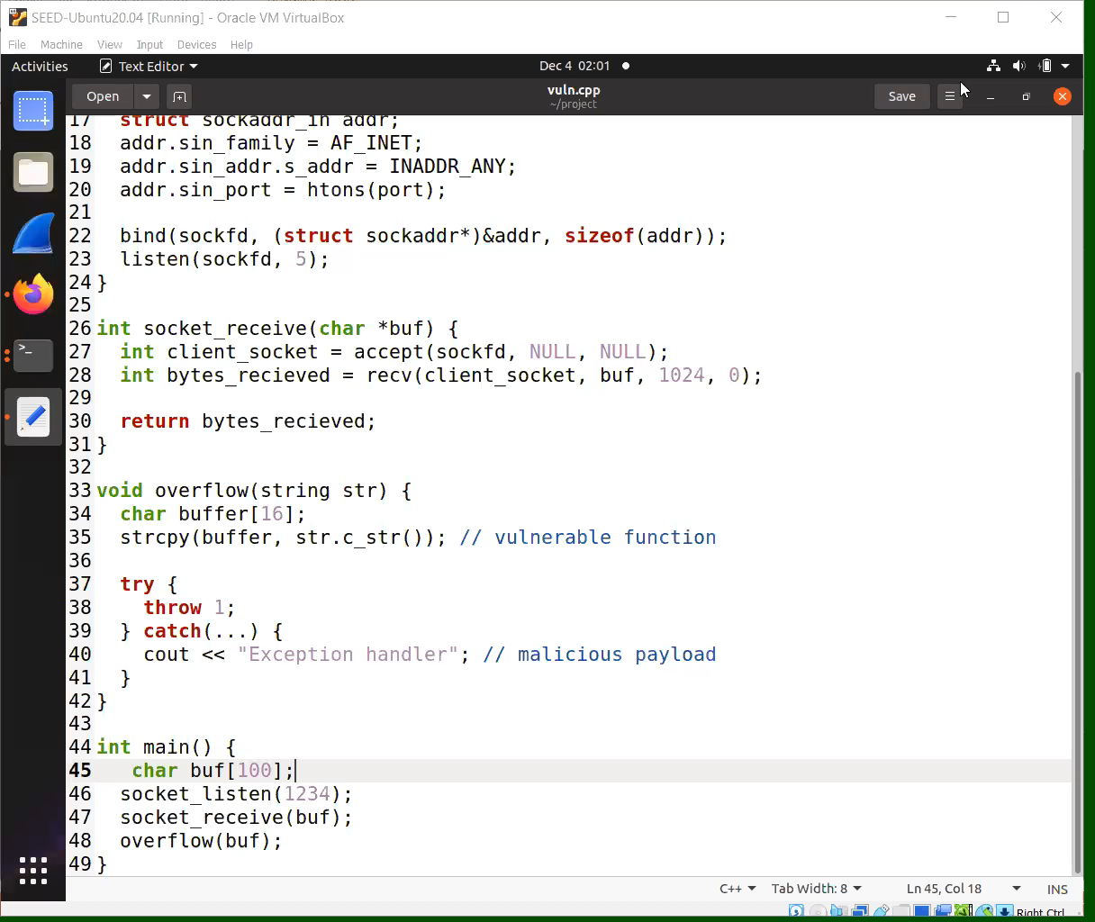
CHOP attack Demo
Notes:
The vulnerable C++ program:
Contains a buffer overflow in overflow() function
strcpy() writes input buf from socket to 16 byte buffer
This overflows the buffer on stack
overflow() throws an exception after overflow
try-catch block throws a generic exception
This will trigger unwinding after stack corruption
The Python script:
Sends payload with buffer overflow strings
Overwrites saved return address with 4 B's
Triggers exception later by sending dummy string
Effect on vulnerable program:
gdb shows SIGABRT signal being received
Indicates abnormal termination due to error
Registers show:
Instruction pointer RIP about to execute __GI_raise
Raised exception 2 (SIGABRT) in eax
Stack pointer RSP pointing to buffer
x/i $pc
Examines instruction at program counter register
Shows it is about to execute a mov reading from corrupted stack
So in summary, you have successfully:
Corrupted the stack including overwriting the saved return address
Caused an exception to trigger unwinding
Diverted control flow to __GI_raise exception handler
The handler is now going to operate on corrupted stack data

Slide 18
Mitigations
Extend stack canary protection to unwinding paths
2. Context-Aware Unwinding:
The unwinder stores information about legit registered exception handlers
3. Limiting Overly Permissive Catch Handlers:
Limit catch-all handlers widely used in libstdc++
4. Randomization:
Randomizing the order of functions in binaries
Notes:
Extending Stack: Every function that invokes __cxa_throw must be protected by a stack canary. Additionally, functions that deploy exception handlers, not just those that throw exceptions, should also be canary-protected.
Context-Aware Unwinding Mechanism
Mechanism: It initiates the unwinding process only if a handler for the thrown exception is present.
Alternative Approach: In the presence of shadow stacks, modifying the unwinder to operate on shadow stack data rather than the original stack.
Compatibility Issues: Both approaches might conflict with the Itanium C++ ABI, requiring significant updates to the unwinding logic.
Limiting Overly Permissive Catch Handlers
Specific Handling: Encouraging every exception to be handled by a specific handler and reducing the number of generic handlers.
Third-party Library Risks: Using third-party libraries with exceptions might still expose programs to CHOP attacks.
Randomization:
Stack Layout Randomization: Altering the layout of the stack in memory.
Limitations: Fine-grained code randomization techniques might not support C++ exceptions due to key assumptions or failure to update metadata used during exception handling.
Randomization defenses, including Address Space Layout Randomization (ASLR), may not be effective against more sophisticated CHOP attack variants, such as those based on data-oriented programming or position-independent code reuse.
These mitigation strategies highlight the need for both enhancing existing security measures (like stack canaries and context-aware unwinding) and adopting new methods (like function reordering and stack layout randomization) to effectively counter CHOP-style attacks

Slide 19

Thank You

